Slide 1
Drawing God
Stations of the Cross
Lent 2020

Slide 2
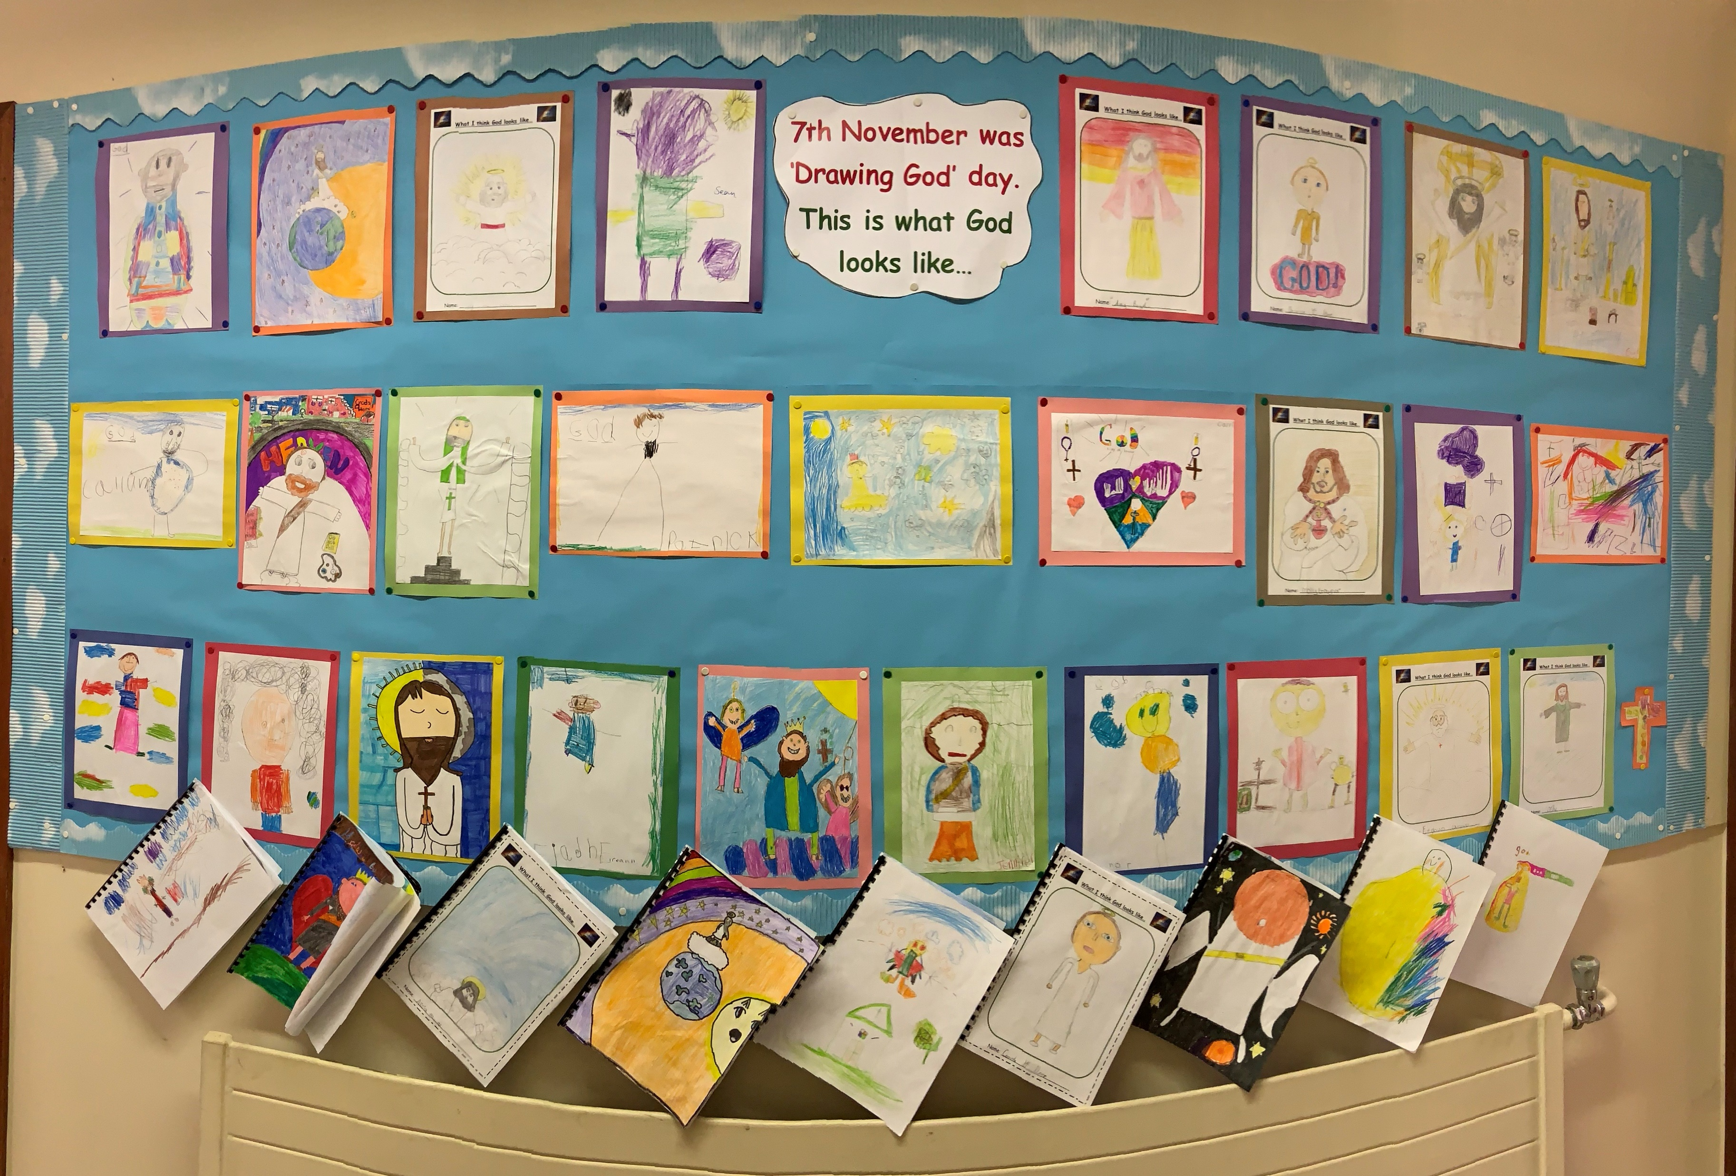
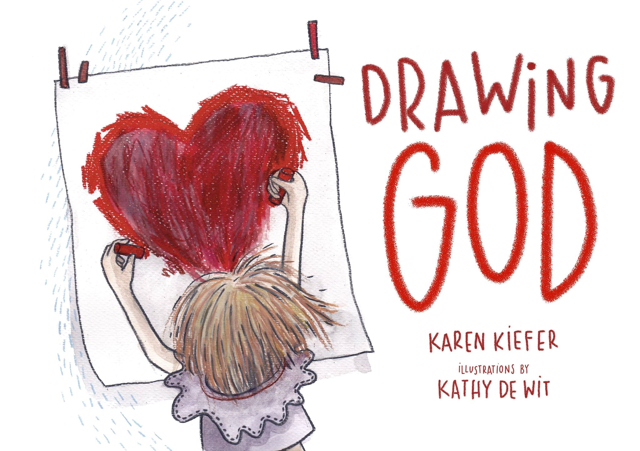
Lots of Children from Derry Diocese took part in Drawing God Day-check out the Virtual Museum-Follow the link at www.drawing-god.com-Amazing!!

Slide 3
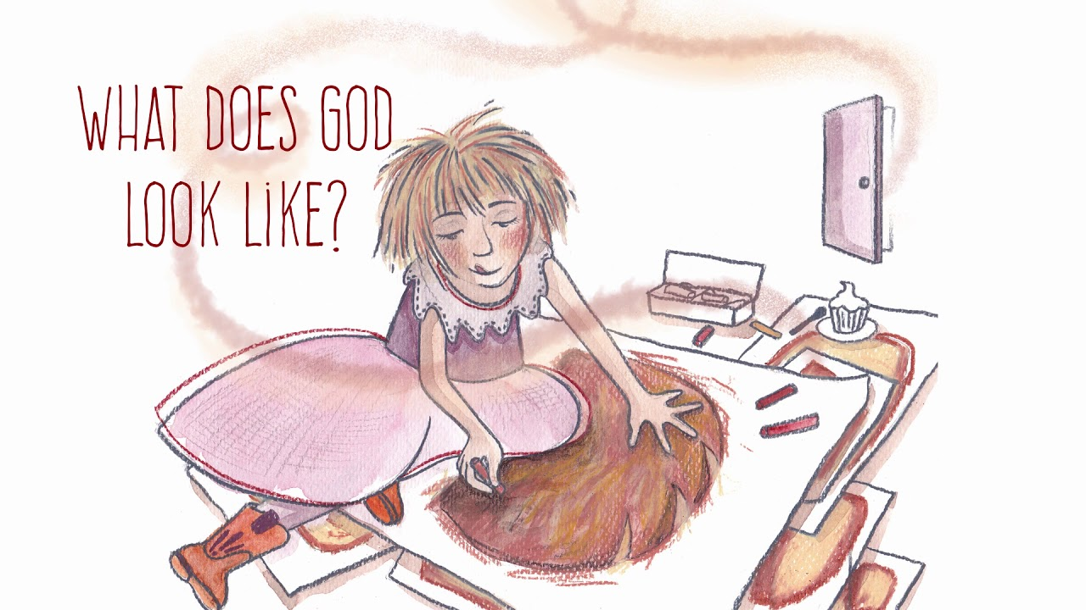
A message from the Author about the Book –Karen Kiefer Just PRESS Ctrl and click on the YOUTUBE link
https://www.youtube.com/watch?v=22hAA01x3Y4&feature=youtu.be

Slide 4
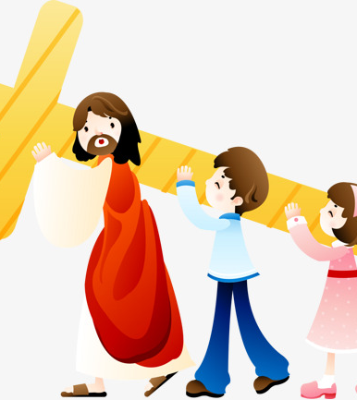
Lent-The Stations of the Cross
The Stations of the Cross can be found in all Catholic Churches. People pray them all year round. But during lent many people pray them to help them walk with Jesus on his journey to the Cross.
Karen, the author of Drawing God has a lovely idea for children, for families-like Emma in Drawing God-filled with faith and love we can draw the Stations of the Cross ourselves this year and stay very close to Jesus, to love and support Jesus when he needs us most.

Slide 5
A New Project-Drawing God-Stations of the Cross
Dear Friends:
We know that life is busy, so we wanted to make it as easy as possible for you to creatively participate in the Drawing God Project during the season of LENT.
After reading the book, Drawing God, we hope that Emma’s contagious faith fills you with ideas and ways to share the vision of the God that lives inside your mind, heart and imagination. This season, we are offering this special Stations of the Cross Kit for our Drawing God Lenten activity.
When I was a child, I loved praying the Stations of the Cross with my mother. Looking back, it was something that the two of us did together, making it even more special. My mother would explain with great tenderness the love and suffering of Jesus in an unforgettable way. Because of that, praying the Stations of the Cross was always memorable rather than scary. I thought that sharing my mother’s gentle understanding of the stations, and coupling it with the Drawing God Project, would be a powerful way to continue growing in love for Jesus while growing our faith imagination this Lent. That way we can really see GOD by drawing GOD.
With you this Lent,
Karen Kiefer Author, Drawing God
https://youtu.be/k9L9quhvDsU

Slide 6
Let’s Get Started
What you will Need!
Paper-small/big-doesn’t matter!
Pencil/Pens/Markers/
Stations of the Cross Templates (we’ve downloaded these for you)
Your Imagination!!!
An old roll of wallpaper if you have it!
And most importantly-a moment of prayer before you draw each Station and at the end of each Station

Slide 7
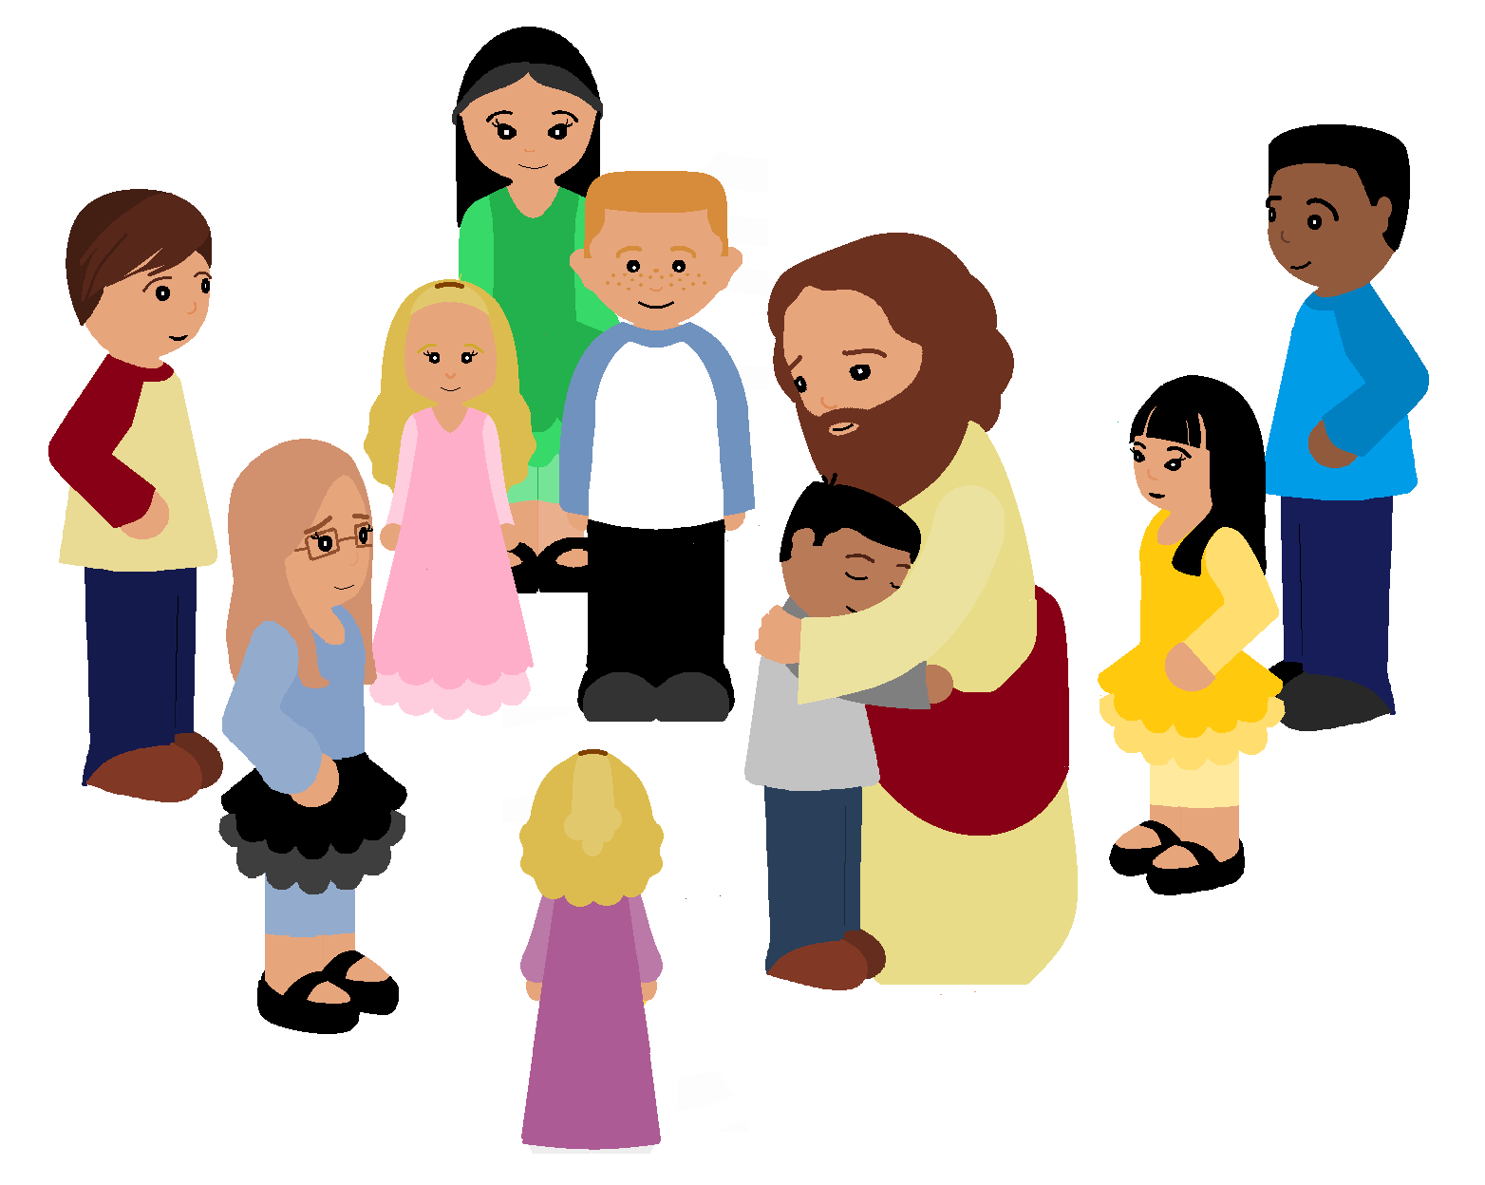
Prayer Before Drawing a Station of the Cross
Prayer After
Drawing a Station of
the Cross
Become very quiet
Breathe in slowly
And say…
Dear God, help me to stay close now to your SonJesus as I pray and draw this Station of the Cross.Amen
Thank you Jesus for your great love for me.
May I always show my love for you by loving others. Amen

Slide 8
Here’s an Example The First Station of the Cross- Jesus is condemned to Death
START with the Prayer Before Drawing a Station of the Cross
READ about the Station
Draw the Station
Finish with the Prayer After Drawing a Station of the Cross
Jesus is sentenced to death and he is an innocent man. This station reminds us of the beginning of his suffering on his way to the crucifixion. We are reminded of the pain he would endure because of his love for us.
In the book, Drawing God, Emma tries to convince her friends that she has drawn God, yet they can’t see God in any of her drawings. How do you think Emma felt when her friends dismissed her drawings?
There are times in our lives when we are treated unfairly, even accused of something we didn’t do. Has that ever happened to you? How did that make you feel?
Have you ever had to suffer a punishment because no one believed that you were innocent? Have you ever tried to convince someone of something that you knew was the truth, but they wouldn’t listen or believe you?
How do you see GOD in this station? DRAW GOD.

Slide 9
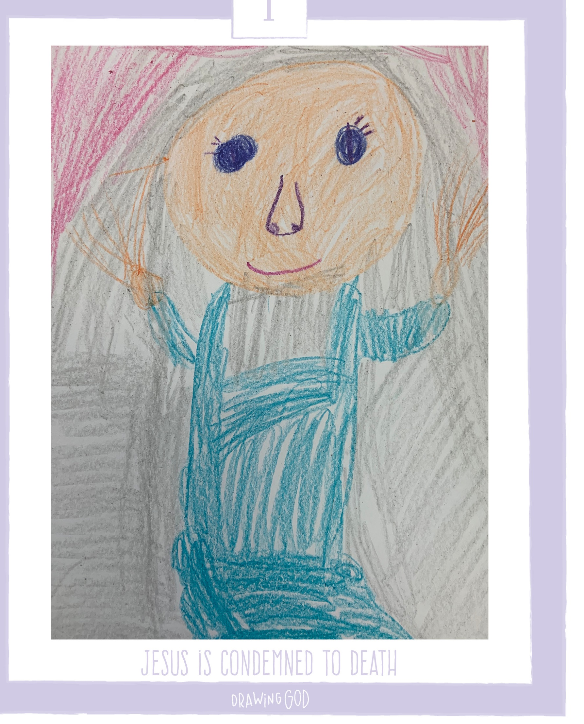

Slide 10
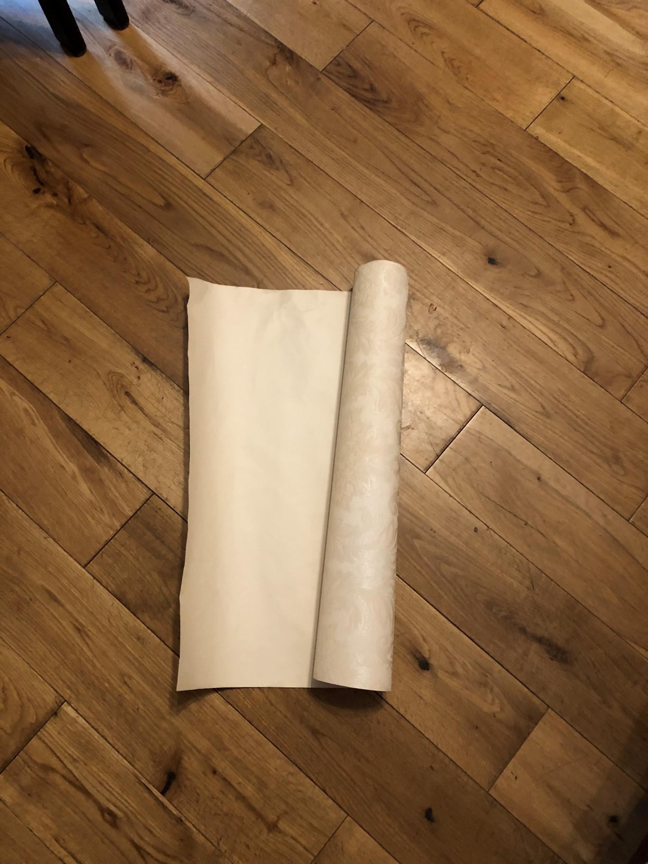
About that Roll of Wallpaper!!!
If there’s a leftover roll of wallpaper in the house, you could stick all of the Stations of the Cross onto it and pray the stations as a family this Lent

Slide 11
Let us See How you Drew God this Lent!
We would love to see your Stations of the Cross
Ask an adult to
Email: Therese Ferry-tferry@derrydiocese.org
Post them to Facebook and Twitter and share with us
The Door of Faith@derrydiocese
https://www.facebook.com/DerryDiocesanCC/

